Slide 1





PA #1 – Escape Room!
You must escape the room through the ‘door’ by taking the ‘key’.
‘Ghost’ will chase you and you must avoid it.
The room is (15, 15) size. The player cannot pass the ‘wall’.
Player(you) moves with left (l), down (d), up (u), and right (r) by keyboard input.
Ghost moves based below policy.
Ghost need to have a rest after 1 move.
If ghost’s x position is larger than player’s x position, move to left(x-1).
If ghost’s x position is smaller than player’s x position, move to right(x+1).
If ghost’s y position is larger than player’s y position, move to up(y-1).
If ghost’s y position is smaller than player’s y position, move to down(y+1).
Key and Door don’t move.
If you don’t have a key, you can’t escape through door.
If the ghost catch you, you lose.
If you take a key and arrive at the door, you win.

Slide 2
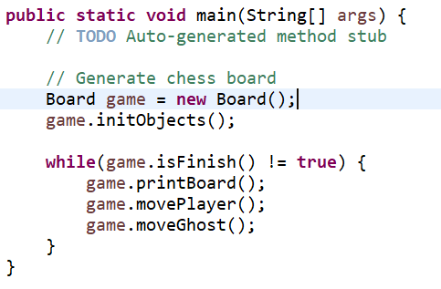
PA #1 – Escape Room!
Procedure of game
1. Initialize room
2. Input Player position
3. Input Ghost position
4. Input Key position
5. Input Door position
6. While ( Game is not finished )
7. Print Current Room
8. Player move
9. Ghost move
Codes
On ICAMPUS, you must download 7 classes and 1 interface.
Board class is implemented with Game interface
Player, Ghost, Key, Door classes are inherited GameObject class.
runGame code use for running game with main method.
You must modify only Board, Player, Ghost, Key, and Door.
Therefore, you don’t have to submit runGame, Game, GameObject files.
Game
GameObject
Board
Player
Ghost
Key
Door

Slide 3

PA #1 – Escape Room!
Initialize Room (Board.java)
The map(board) looks like below. Please use below code to initialize room.
White one is an empty space that player, key, and door can exist.
Black one is a wall which player can’t pass through. But, ghost can pass through the wall.
Player and ghost can not go outside of this room.
X
board = new char[][] {
{' ','■',' ',' ',' ',' ','■',' ','■',' ',' ',' ',' ',' ',' '},
{' ','■',' ','■','■','■','■',' ','■',' ','■',' ','■','■',' '},
{' ','■',' ',' ',' ','■',' ',' ','■',' ','■',' ',' ','■',' '},
{' ','■',' ','■',' ','■',' ','■','■',' ','■','■',' ','■',' '},
{' ',' ',' ','■',' ','■',' ',' ',' ',' ',' ',' ',' ',' ',' '},
{' ','■','■','■',' ',' ',' ','■','■','■','■','■','■','■',' '},
{' ',' ',' ',' ',' ','■',' ',' ',' ',' ',' ',' ',' ','■',' '},
{'■','■',' ','■','■','■',' ','■','■','■','■','■',' ','■',' '},
{' ',' ',' ',' ',' ',' ',' ','■',' ',' ',' ',' ',' ','■',' '},
{' ','■','■',' ','■','■',' ','■',' ','■','■','■',' ','■',' '},
{' ','■',' ',' ',' ',' ',' ','■',' ',' ',' ','■',' ','■',' '},
{' ','■',' ','■','■','■','■','■','■','■','■','■',' ','■',' '},
{' ','■',' ',' ',' ',' ',' ',' ',' ',' ',' ',' ',' ','■',' '},
{' ','■','■','■',' ','■','■','■','■','■','■','■',' ','■',' '},
{' ',' ',' ',' ',' ',' ',' ',' ',' ',' ',' ',' ',' ',' ',' '}
};
Y

Slide 4
PA #1 – Escape Room!
Setting Player
Player class is inherited GameObject class.
At first, you have to get player’s position. Receive input repeatedly until it is valid.
If it is empty space(not wall) and range is 0~14, position is valid.
Setting Ghost
Ghost class is inherited GameObject class.
At first, you have to get ghost’s position. Receive input repeatedly until it is valid.
If it isn’t overlapped with player and range is 0~14, position is valid.
Setting Key, Door
Key, Door classes are inherited GameObject class.
At first, you have to get key(and Door) position. Receive input repeatedly until they are valid.
If they aren’t overlapped with player and it is empty space and range is 0~14, position is valid.

Slide 5
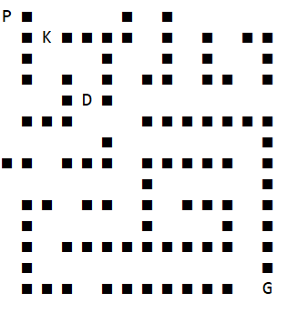
PA #1 – Escape Room!
If player arrive at door with key, player wins. Print “YOU WIN” and quit the program.
If ghost catch the player, player loses. Print “YOU LOSE” and quit the program.
If player arrive at door and ghost catch player at the same time, player wins. Print “YOU WIN” and quit the program.
While the game is not over, player and ghost move.
At every turn you should print current room state.
Empty space = ‘ ‘(space), wall = ‘■‘, Ghost = ‘G’, Player = ‘P’, Key = ‘K’, Door = ‘D’.
Print priority when overlapped : P > G > K, D > Wall, Space
After player takes the key, you must not print key object.

Slide 6
PA #1 – Escape Room!
Player move
Using keyboard input(you can use scanner), move the player.
‘u’ → up, ‘d’ → down, ‘l’ → left, ‘r’ → right
If target position is wall or out of range, player can’t move.
Ghost move
Ghost need to have a rest after 1 move.
E.g., 1st turn : move, 2nd turn : rest, 3rd turn : move …
If ghost’s x position is larger than player’s x position, move to left(x-1).
If ghost’s x position is smaller than player’s x position, move to right(x+1).
If ghost’s y position is larger than player’s y position, move to up(y-1).
If ghost’s y position is smaller than player’s y position, move to down(y+1).
P
P
P
….
G
G
G
G
P

Slide 7
PA #1 – Escape Room!
Coding guide
In Board.java class, you have to implement 5 interface methods.
public void printBoard() : print current room state
public void initObject() : Initialize Objects(Player, ghost, key, door)
public void movePlayer() : move player with keyboard input
public void moveGhost() : move ghost with above policy
public boolean isFinish() : check game is finished or not.
In Key.java, Player.java, Ghost.java, Door.java, you have to implement a constructor.
Constructor : settings position with keyboard input
You can add any functions which you want

Slide 8
PA #1 – Escape room!
Grading policy
Game works : 20 points
Game Initialized well : 20 points
Ghost and Player moves well : 20 points
Test cases (Nondisclosure) : 40 points (4 test cases, each 10 points)
Submission Guide
You must submit Ghost.java, Player.java, Key.java, Door.java, Board.java files.
You don’t have to submit GameObject.java, Game.java, runGame.java files.
Submit files on ICAMPUS with compressing to “student_id.zip”
Due date is 4/12 23:59:00

Slide 9
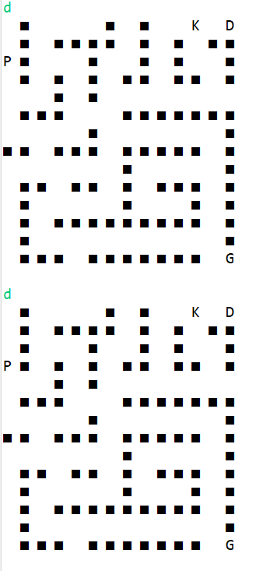
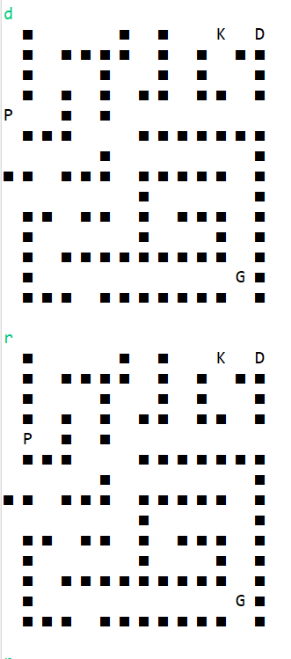
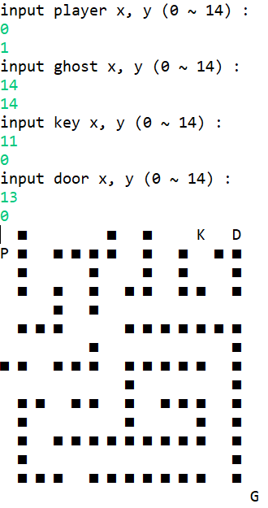
Sample Output Game
Please watch example video on ICAMPUS
9

